Slide 1
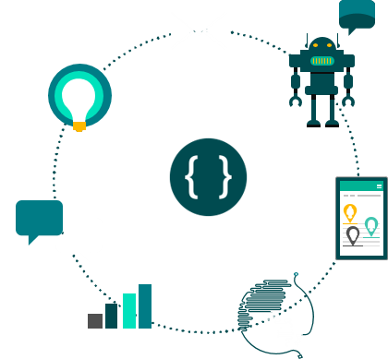

LUIS: Language Understanding Intelligent Service
Mithun Prasad, PhD miprasad@Microsoft.com

Slide 2
Key Concepts
Utterance
Textual input from the user that your app needs to interpret
Example: "Book me a ticket to Paris", "Booking", "Paris flight“
Intents
An intent is an action the user wants to perform
Verbs/Goal expressed in a user's input
Example: "booking a flight", "paying a bill", "finding a news article“
Define a set of named intents:
“Book me a ticket to Paris” -> BookFlight

Slide 3
Key Concepts
Entities
A class of object that is relevant to a user’s intent
Nouns
Example: "Book me a ticket to Paris" -> "Paris“
Pick the actions to fulfill an intent
Classes of similar objects
Names
Locations
Time Expressions
Money Expressions

Slide 4
Types of Entities
Type | Description
Prebuilt | Built-in types that represent common concepts like dates, times, and geography
List | Variations, synonyms, same concept
Simple | A simple entity is a generic entity that describes a single concept
Hierarchical | A hierarchical entity defines a category and its members For example, in a travel agent app, you could add hierarchical entities like these: $Location, including $FromLocation and $ToLocation as child entities that represent origin and destination locations $TravelClass, including $First, $Business, and $Economy as child entities that represent the travel class
Composite | A composite entity is made up of other entities that form parts of a whole

Slide 5
Prebuilt Entities
Entity | en-US | fr-FR | it-IT | es-ES | zh-CN | de-DE | pt-BR | ja-JP | ko-kr
Datetime | Y | Y | Y | Y | Y | Y | Y | Y | -
Number | Y | Y | Y | Y | Y | Y | Y | Y | -
Percentage | Y | Y | Y | Y | Y | Y | Y | Y | -
Temperature | Y | Y | Y | Y | Y | Y | Y | Y | -
Dimension | Y | Y | Y | Y | Y | Y | Y | Y | -
Money | Y | Y | Y | Y | Y | Y | Y | Y | -
Age | Y | Y | Y | Y | Y | Y | Y | Y | -
Geography | Y | - | - | - | - | - | - | - | -
Encyclopedia | Y | - | - | - | - | - | - | - | -
URL | Y | - | - | - | - | - | - | - | -
Email | Y | - | - | - | - | - | - | - | -
Phone number | Y | - | - | - | - | - | - | - | -

Slide 6
Examples of Prebuilt Entities
Pre-built entity | Example Utterance | JSON
builtin.number | ten | { "type": "builtin.number", "entity": "ten" }
builtin.number | 3.1415 | { "type": "builtin.number", "entity": "3 . 1415" }
builtin.ordinal | first | { "type": "builtin.ordinal", "entity": "first" }
builtin.ordinal | 10th | { "type": "builtin.ordinal", "entity": "10th" }
builtin.temperature | 10 degrees celcius | { "type": "builtin.temperature", "entity": "10 degrees celcius" }
builtin.temperature | 78 F | { "type": "builtin.temperature", "entity": "78 f" }
builtin.dimension | 2 miles | { "type": "builtin.dimension", "entity": "2 miles" }

Slide 7
Example of Intent
Example intent | Example utterances
BookFlight | Book me a flight to Rio next week Fly me to Rio on the 24th I need a plane ticket next Sunday to Rio de Janeiro
Greeting | Hi Hello Good morning
CheckWeather | What's the weather like in Boston? Show me the forecast for this weekend
None | Get me a cookie recipe
- All applications come with the predefined intent, "None"

Slide 8
How do Intents Relate to Entities?
Example intent | Entity | Entity in example utterances
CheckWeather | { "type": "location", "entity": "seattle" } | What's the weather like in Seattle?
CheckWeather | { "type": "date_range", "entity": "this weekend" } | Show me the forecast for this weekend

Slide 9
Features
Features are not intents or entities
Features might provide examples of related terms, or a pattern to recognize in related terms
Type | Description
Phrase list | A phrase list includes a group of values (words or phrases) that belong to the same class
Pattern | A pattern specifies a regular expression to help LUIS recognize regular patterns that are frequently used in your application's domain

Slide 10
Types of Features - Patterns
A pattern feature includes regular expression or regex
Example: To recognize KnowledgeBaseArticle, the regex can be "kb\d+" for identifying knowledge base article IDs
Kb8732827
Kb3333337
Enter some utterances and label the entity

Slide 11
Use Prebuilt Domains in LUIS Apps
Prebuilt domain | Description
Camera | Taking pictures and recording videos
Communication | Sending messages and making phone calls
Entertainment | Handling queries related to music, movies, and TV
Places | Handling queries related to places like businesses, institutions, restaurants, public spaces and addresses
Utilities | Handling requests that are common in many domains, like "help", "repeat", "start over"

Slide 12
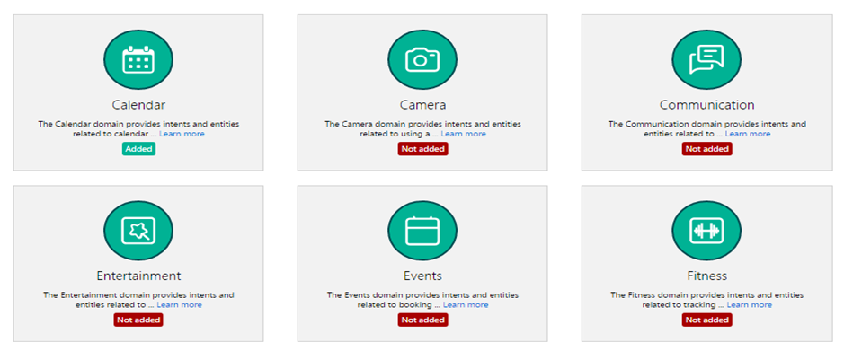
Use Prebuilt Domains in LUIS Apps

Slide 13
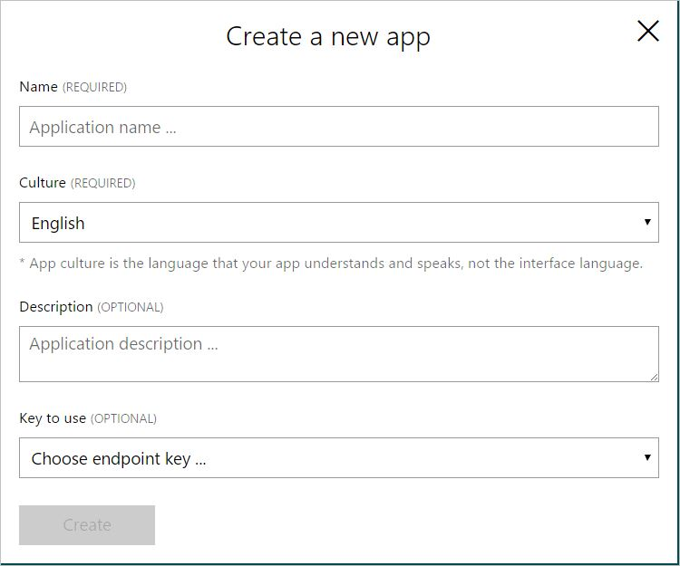
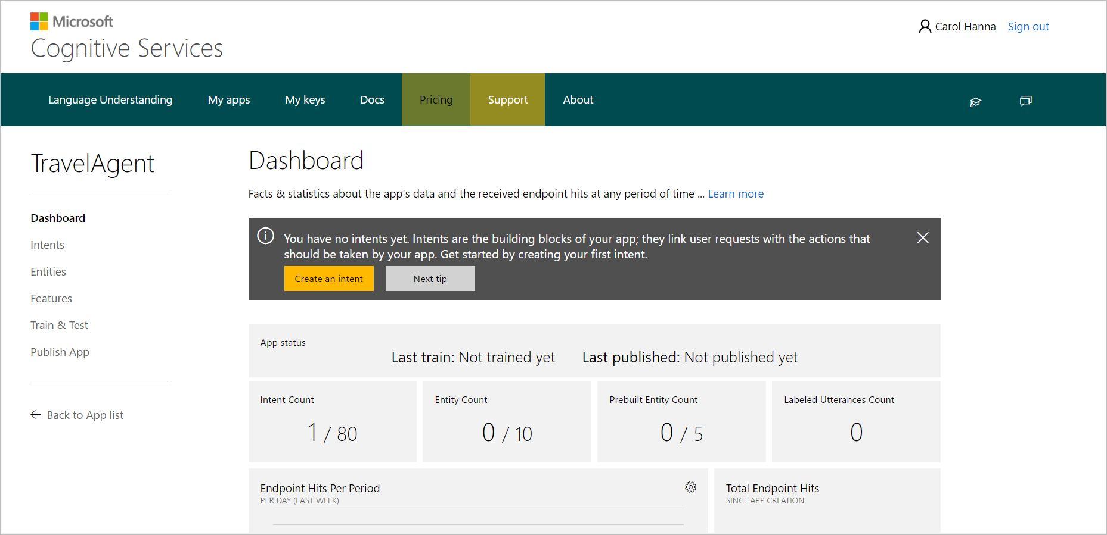
Create a New App

Slide 14
Add and Train Intents
All applications come with the predefined intent - None
Train the app to recognize user statements that are irrelevant to the app
Example:
"Get me a great cookie recipe" in a travel agent app, label that utterance with the None intent
You can add up to 80 intents in a single LUIS app

Slide 15
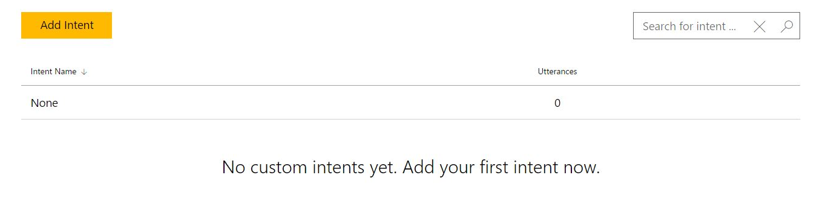
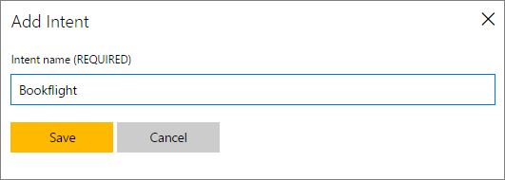
Add Intents
- Adding BookFlight Intent

Slide 16
Add Example Utterances
LUIS learns from utterances
By constantly adding more utterances and labeling them, you are enhancing your application’s language learning experience
The more relevant and diverse examples you add to the intent, the better intent prediction you get from your app
For example,
“book me a flight to Paris”
“Reserve me a flight to Paris”
"book me a ticket to Paris"
"Get me a ticket to Paris”
"Fly me to Paris“
"Take me on a flight to Paris"

Slide 17
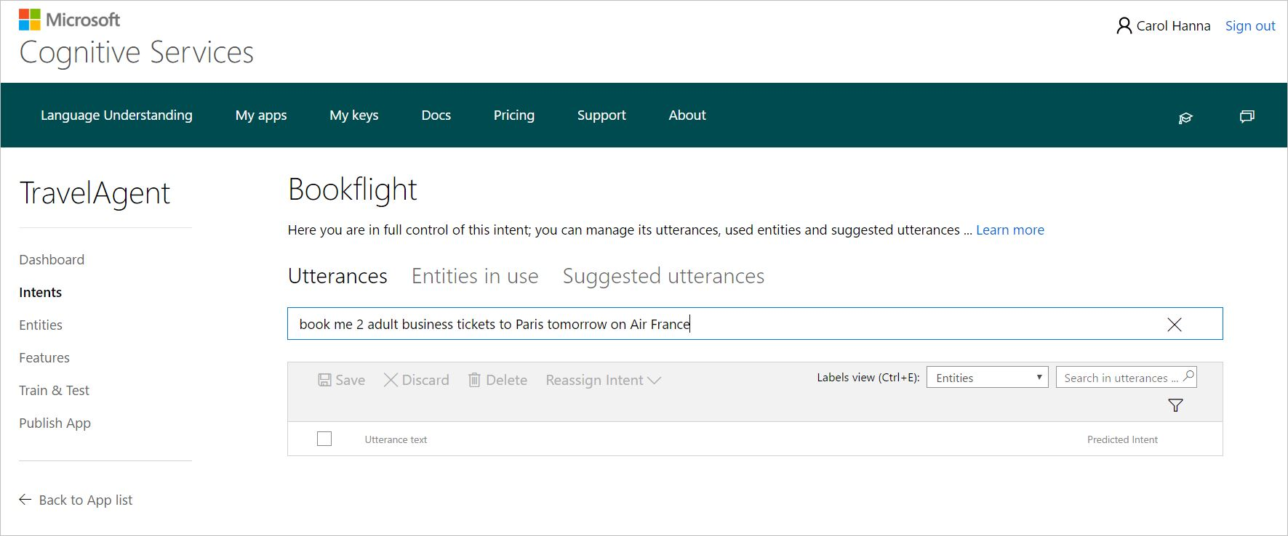
To Add an Utterance
Book me 2 adult business tickets to Paris tomorrow on Air France

Slide 18
Label Utterances
After adding utterances, we need to label them
Utterances are labeled in terms of intents and entities
Adding an utterance in an intent page means that it is labeled under this intent
You only need to label custom entities, because prebuilt entities are detected and labeled automatically by your app

Slide 19
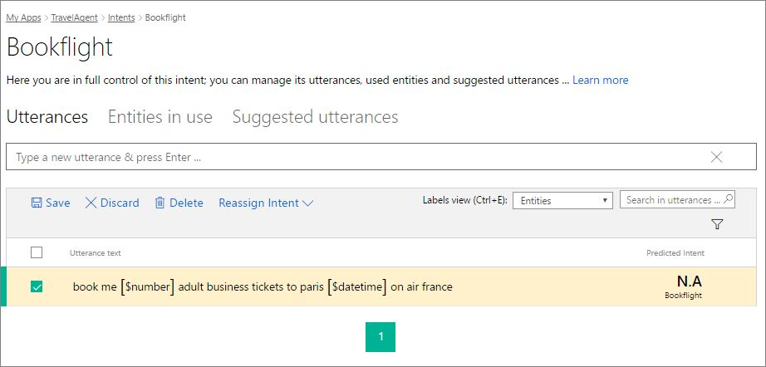
Label Utterances - Example
“book me 2 adult business tickets to Paris tomorrow on Air”
number and datetime are identified automatically from the example text
2 is labeled as number and "tomorrow" as datetime

Slide 20
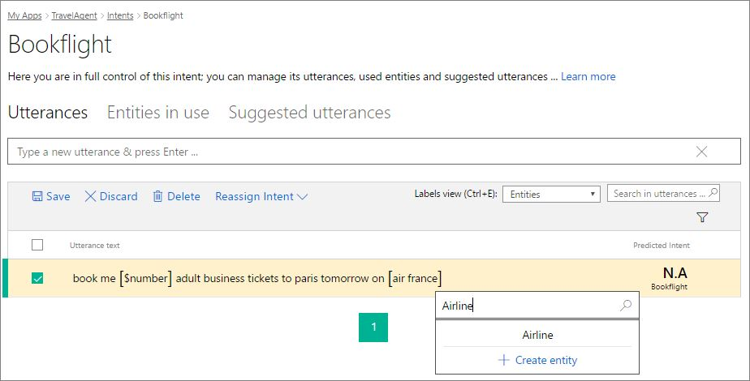
Label Custom Entities

Slide 21
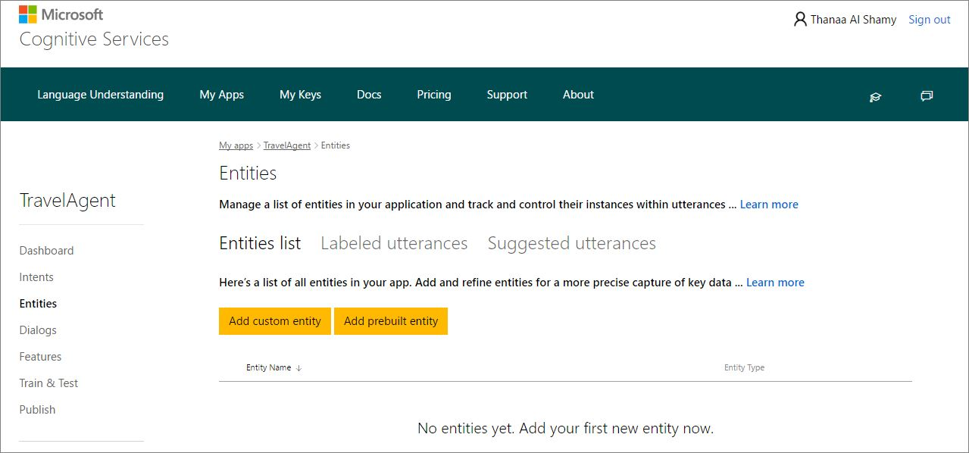
Add Entities
You can add up to 30 entities in a single LUIS app
Add prebuilt entities

Slide 22
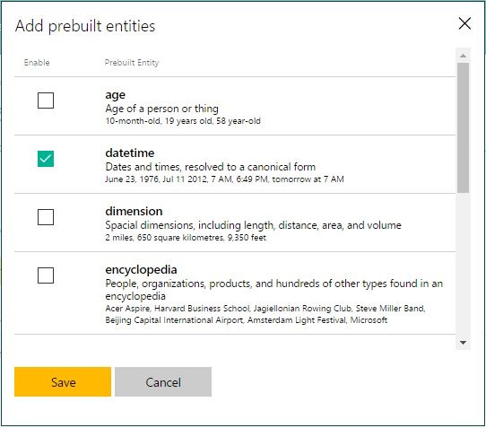
Add Prebuilt Entities
To add datetime

Slide 23
Custom Entities
Simple: a generic entity
Hierarchical: a parent including children (sub-types) which are dependent on the parent
Composite: a compound of two or more separate entities combined together forming a composite and treated as a single entity
List: a customized list of entity values, to be used as keywords or identifiers to recognize the entity within utterances

Slide 24
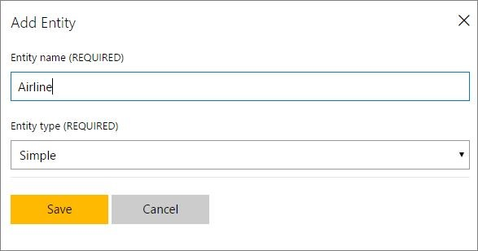
Simple Entity

Slide 25
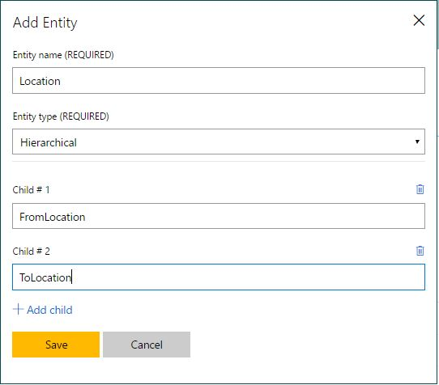
Hierarchical Entity

Slide 26
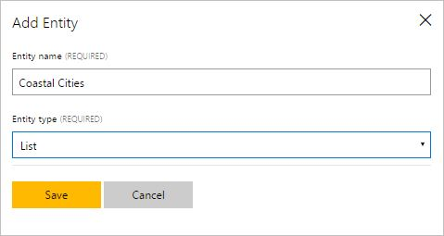
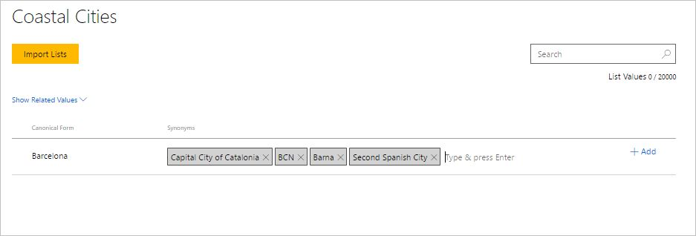
List Entity
Manually add lists
Import list from file

Slide 27
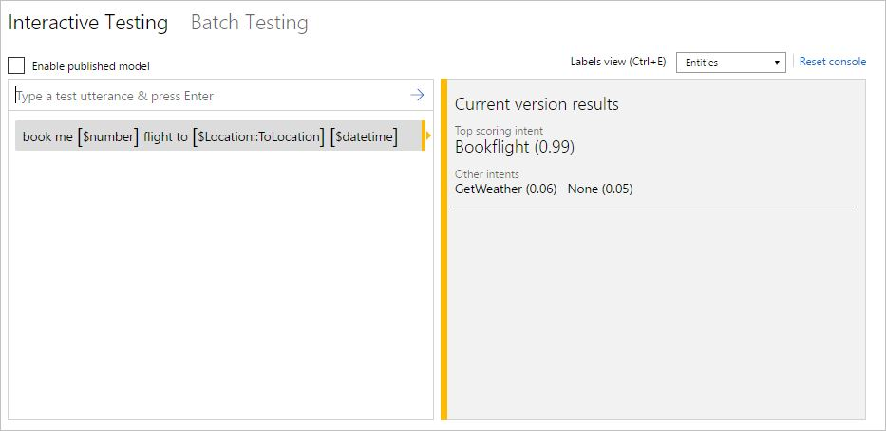
Train and Test Your App
Interactive testing
Batch testing:
Large number of test utterances in a batch file
JSON format
<1000 utterances
Validation Visualization

Slide 28
Publish Your App
Publish the app as a web service on Azure
Get an HTTP endpoint
Production Slot: Publish your app directly to the Production Slot where end users can access and use your model
Staging Slot: Publish your app to the Staging Slot where you can iteratively test your app to validate changes before publishing to the production slot

Slide 29
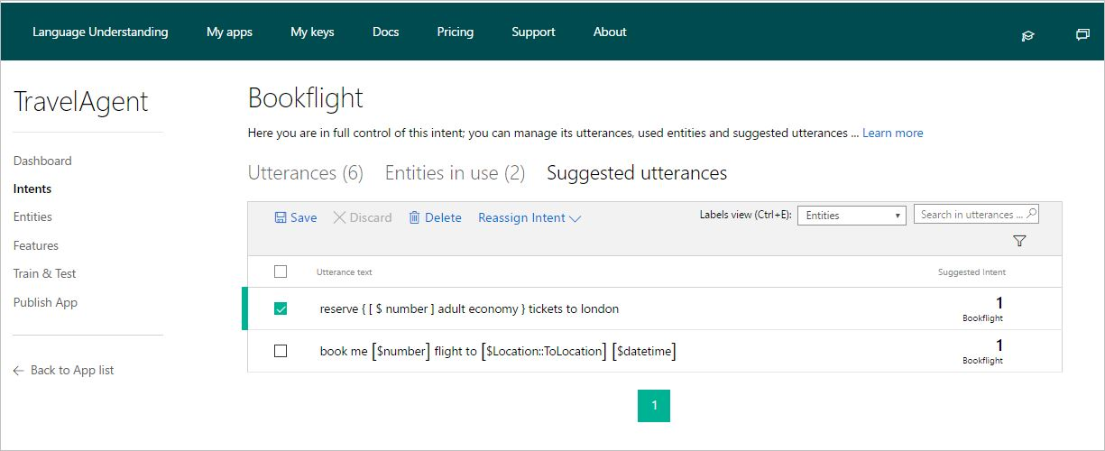
Suggested Utterances
Suggested utterances are from end-user queries on the application’s HTTP endpoint
If the app is not published or has not received hits yet, you will not have any suggested utterances
You will not get suggested utterances for an intent/entity if no endpoint hits are received on this intent/entity

Slide 30
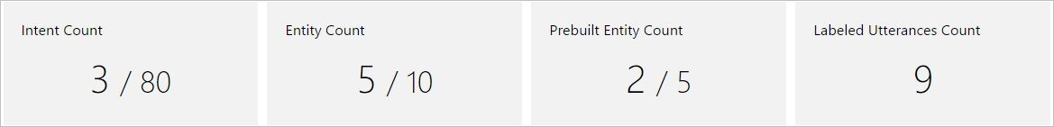
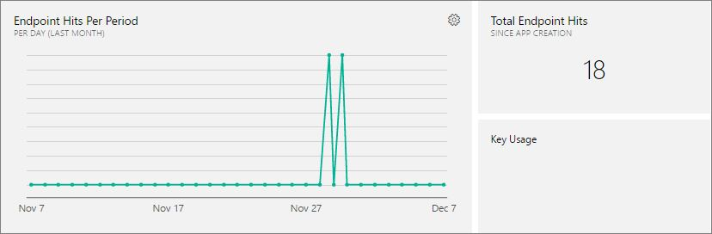
Monitor your App
The app dashboard is a visualized reporting tool which enables you to monitor your app at a single glance
Displays significant data compiled from multiple app pages
Model Data Statistics
Endpoint Hits

Slide 31
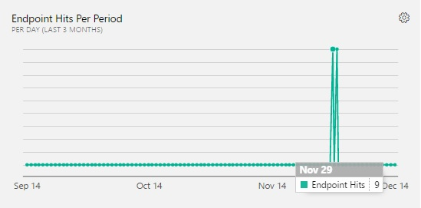
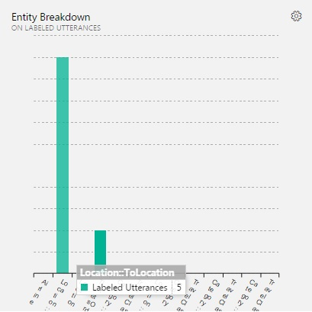
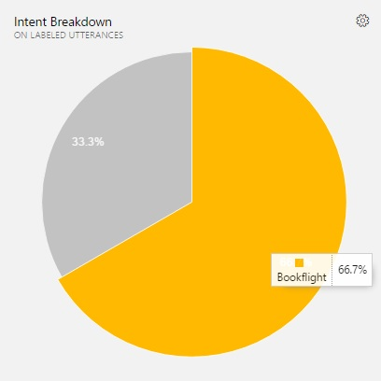
Monitor your App

